Slide 1
Online Retail Customer and Sales Analysis
Bryan Mahony

Slide 2
Problem Statement
A UK-based online retailer known for unique, all-occasion giftware is looking to increase its customer retention and develop more targeted product strategies.
They shared 18 months of sales data from which they were looking to identify:
Unique customer profiles and potential revenue generating strategies for each
Patterns in sales for specific products
Any other insights which could boost sales and revenue generation

Slide 3
Executive Summary
Using an RFM analysis, we can segment the customer base into three distinct customer profiles within the specified time segment. Based on the analysis we can suggest targeted marketing strategies to boost revenue from each segment.
There are 88 products which represent a subset of the highest-grossing products on OnlineCo’s website and are represented in the top 50 most purchased products across each customer segment, suggesting that broad-based marketing campaigns for these products could boost revenue across all customer segments.
We also used Tableau to visualize sales data to identify several key trends with significant business implications for OnlineCo.

Slide 4
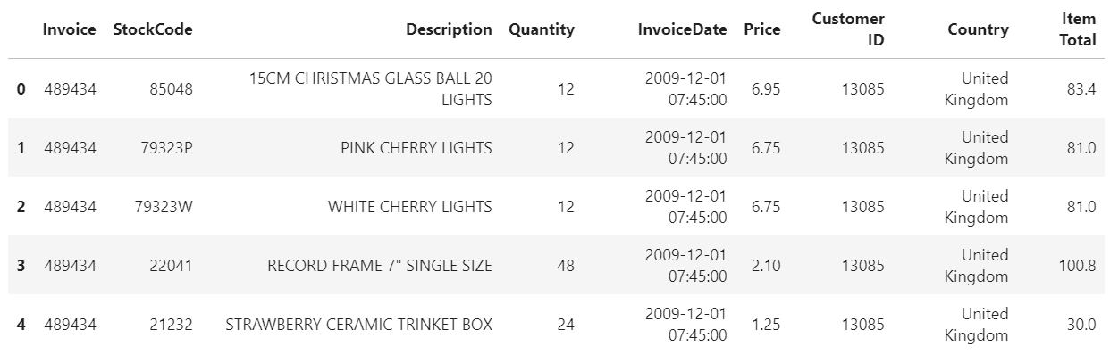
Data Source
The sales data shared by OnlineCo covers a time period of 18 months between 1/12/20 and 9/12/20. Each of the 525,460 rows in the database represents a product purchased online, grouped by an invoice number and a customer ID (where applicable). Each row contains 9 features describing the product and its sale.

Slide 5
Analysis Overview – RFM approach
Based on the relatively short time period covered by the data, we chose an RFM analysis (recency, frequency, monetary value) to assess customer segmentation. This seeks to understand the distribution of the customer base along three dimensions:
Recency of purchase – how long has it been since the customer’s most recent transaction?
Frequency of purchases – how many times has a customer purchased from us during the time period?
Monetary value of purchases – how much has the customer spent with us over the time period?

Slide 6
Analysis Overview – EDA
Through our exploratory data analysis, we found the following:
The dataset covers 28,816 unique transactions, of which 4,592 were returns (we will separate these and treat them differently later in the analysis)
We have 4,383 identified customer IDs, but 20% of the data does not have a customer ID associated with them and do have an invoice code. We will group that 20% by invoice code and treat them as unique, guest customers.
Of the 4,383 customers, the top 25 customers performed 2,081 transactions (7% of total volume). Of the total sales volume of $9.46M over the time period, these top customers represent $1.02M – or 10.8% - of the total revenue.

Slide 7
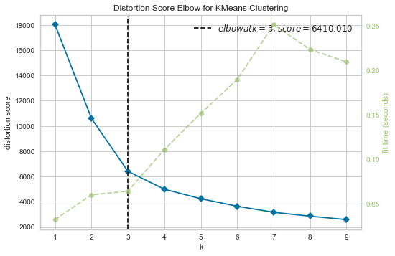
Analysis Overview – RFM analysis / K-means clustering
After grouping our customers by recency, frequency, and monetary value*, we used a cross-validated KMeans clustering approach to identify clustering patterns in customer profiles – i.e. identifying customer segments.
Using yellowbrick’s KMeansVisualizer, we can see that a K of 3 produces the optimal distortion score – that is, there are three optimal segments in our customer data.
* Information on the RFM approach is included in the appendix

Slide 8
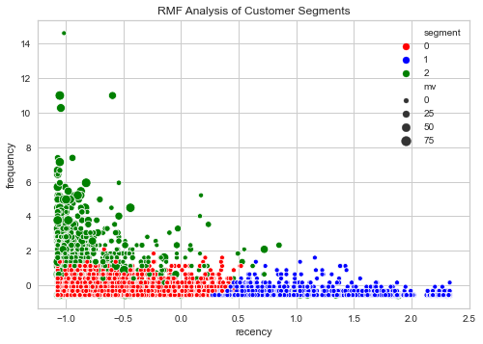
Analysis Overview – RFM analysis / K-means clustering
Using a k of 3, our KMeans model can assign each of our customers to one of the 3 segments.
In the visual on the right, you see the segments represented by color, with (scaled) frequency and recency on the axes and size of the datapoint indicating monetary value.

Slide 9
Analysis Overview – RFM analysis / K-means clustering
We can intuit our three customer profiles as follows based on the graph and the cluster centers provided by our KMeans model:
Low frequency, low recency, low MV customers - customers who have purchased recently, have a small number of overall purchases, and make relatively lower total purchases (indicated in red)
Low frequency, high recency, low MV customers - customers who have not purchased recently with a small number of overall purchases, and a low total purchase volume (indicated in blue)
High frequency, high recency, high MV customers - customers who purchase relatively often and recently, and have a high purchase volume (indicated in green)
Our strategic recommendations will consider these profiles in light of their overall value and their purchasing habits.

Slide 10
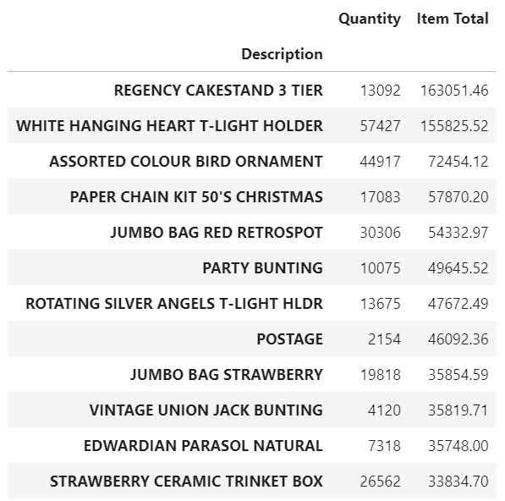
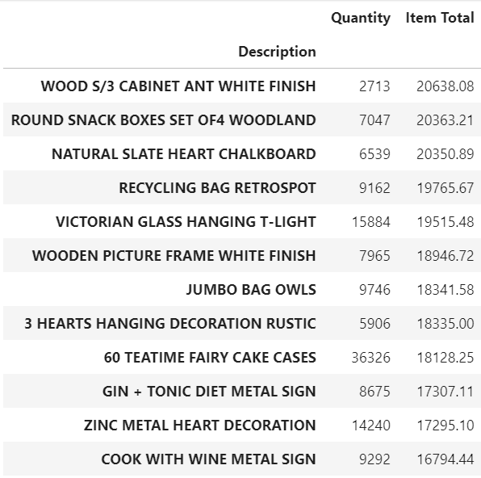
Analysis Overview – Product Sales
Through transaction-level analysis, we have identified the top-grossing products as well as the products most often purchased in the same transactions as the most popular products.
Top-grossing products
Top-grossing copurchases

Slide 11
Strategy Recommendations for Customer Segments
 | Segment 0 | Segment 1 | Segment 2
Description | Low frequency, low recency, low MV | Low frequency, high recency, low MV customers | High frequency, high recency, high MV customers
Total sales over time period | $5.87M | $2.72M | $.86M
Total customer # | 3,615 | 755 | 1957
Avg transactions/customer | 3.95 | 11.38 | 1.34
Median transaction value | $229.57 | $247.60 | $139.34
Strategy type | Upselling | Reacquisition | Retention

Slide 12
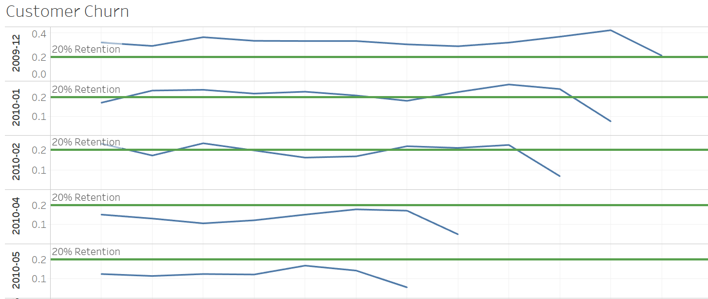
Analysis Overview – Customer Retention by Cohort
We can view customer churn by time cohort of first purchase in the dataset. We can see, using a standard goal of 20% customer retention, that newer cohorts are underperforming in terms of retention.

Slide 13
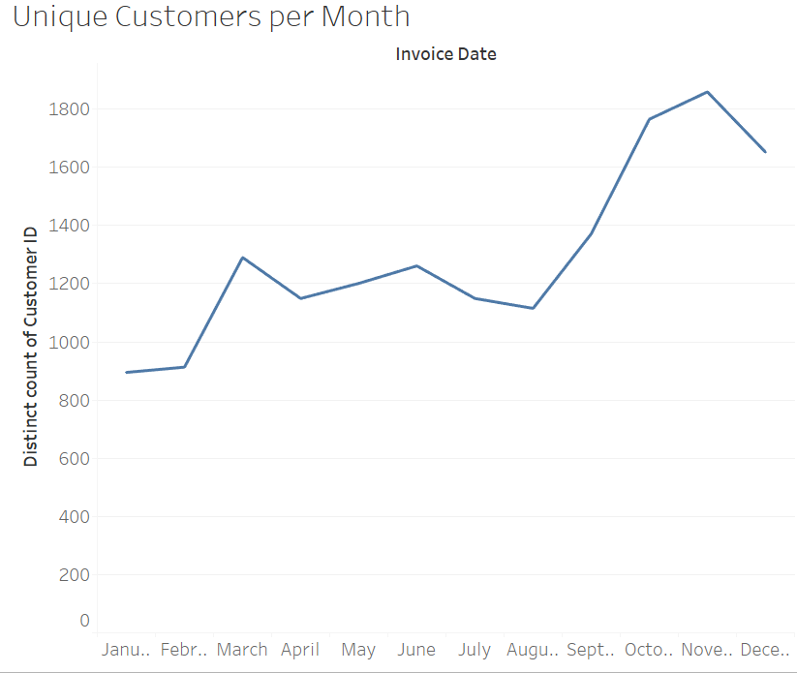
Analysis Overview – Unique Customers Over Time
The absolute number of customers has increased over the past ~4 months at a more rapid pace than we've seen before. Does increased customer base = lower touch/engagement = lower retention?

Slide 14
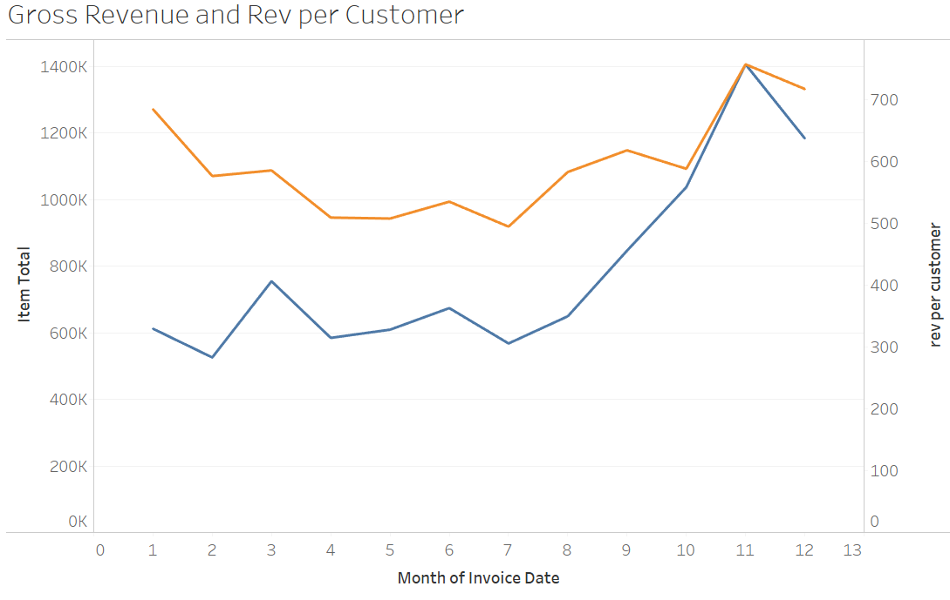
Analysis Overview – Gross Rev/Rev per Customer
We can see that there is a strong seasonality in our sales - to be expected as the client is a seasonal gifts webstore. Importantly, we can see that revenue per customer goes up dramatically as well, indicating that our customer acquisition strategies are working effectively.

Slide 15
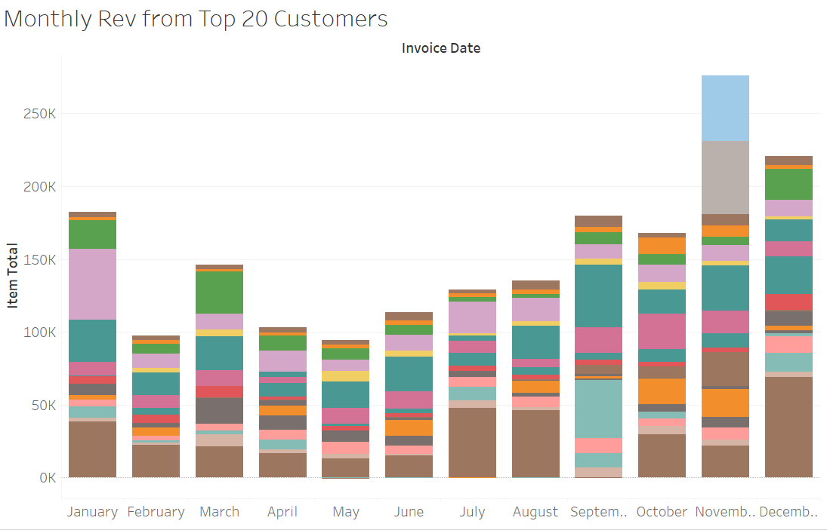
Analysis Overview – Top 20 Customers Monthly Rev
We see a similar trend in our top 20 customers - a strong seasonality but also a dip in this group in December. We know we increased both the number of customers and the revenue per customer during the last month of the year, so we may want to focus our engagement/upselling tactics with this top segment.

Slide 16
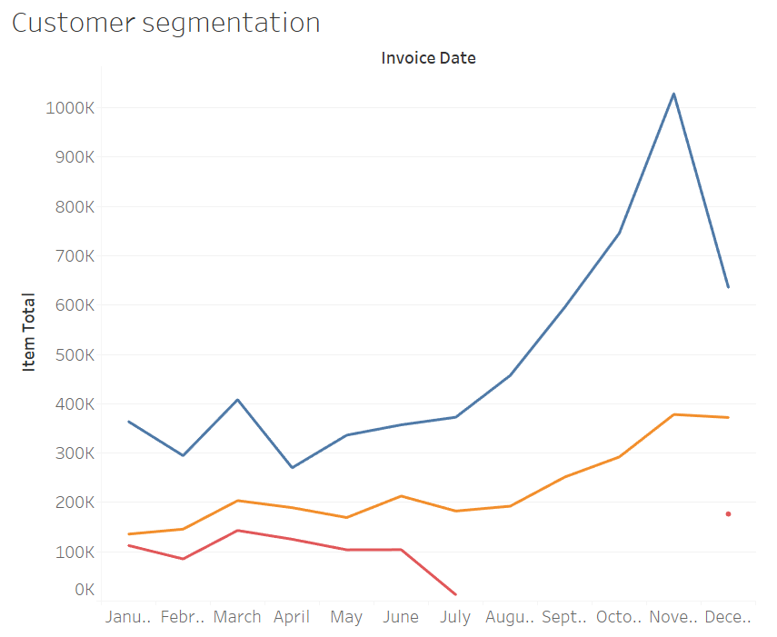
Analysis Overview – Rev by Customer Segment
From our previous segmentation exercise, we know we have three distinct segments - and can see below their various purchasing patterns. The dip in December is still noticeable for our top revenue generating group.

Slide 17
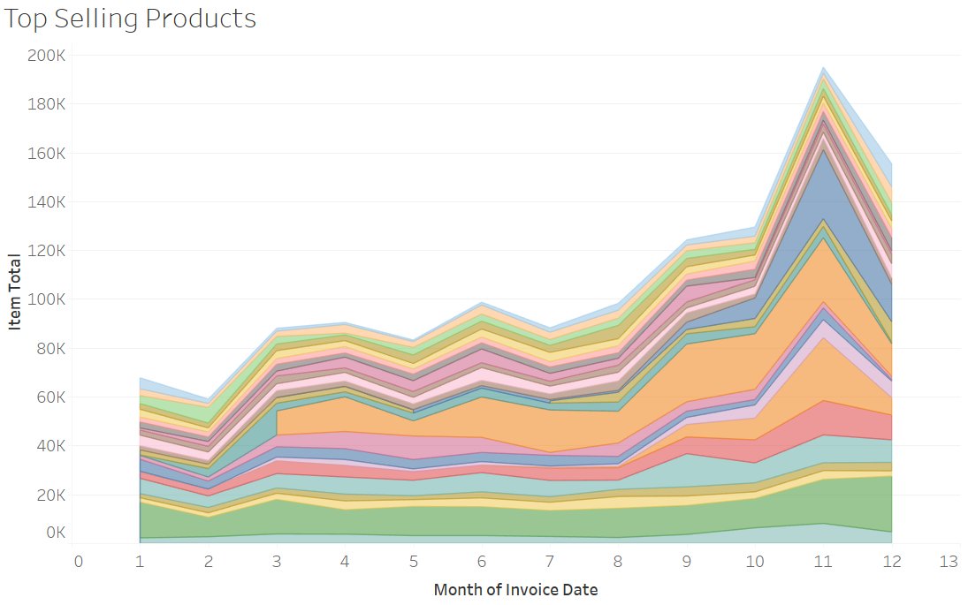
Analysis Overview – Seasonality of Product Sales
Our 25 top selling products also see this dip. And we can see that, while sales of some increase over time, our largest sellers tend to vary revenue over time. Developing a more refined understanding of what purchases may be correlated and the underlying factors playing into their seasonality could help us generate more revenue in the future.

Slide 18
Summary Recommendations
OnlineCo has the opportunity to better target customer acquisition and retention strategies based on newly-identified customer profiles.
OnlineCo has significant opportunities to improve sales and customer retention in light of seasonality identified in purchasing behavior
OnlineCo now has a framework to approach revenue generation by cross-promoting frequently copurchased products, focusing campaigns during peak potential purchase times, and driving customer retention of larger numbers of newly-acquired customers to the same levels as previously seen

